Slide 1
Now Advertising has become easy, effective and economical!
VideoAdsHyderabad.Com
is an exclusive online video Advertising Portal to promote your Products & Services in Hyderabad. Online Video Advertising can help you to promote your business with very reasonable Prices than any other Media like Print (News Paper) and TV.

Slide 2

Power of Visual Communication
We all know the power of visual communication system in today’s Business Scenario. Videos are as effective as TV in building awareness of your business.

Slide 3
How it will be helpful-example
To get results and increase your traffic to your website, for example if a Builder (or) Construction Company, Constructed an Apartment in Hyderabad and they want to advertise, they have to shoot the Apartment video with front elevation of the Apartment, car parking area, flat entrance, hall, master bed room, other bed rooms, kitchen, bathrooms and all other emanates in the flat to promote it as a TV-Style Ad in Hyderabad based VideoAdsHyderabad.Com at very low cost. If people search in Google search engine for 3 bhk Apartments in Kukatpally from anywhere in the world, you will find our site in PC’s, tablets and Smart Phones.

Slide 4
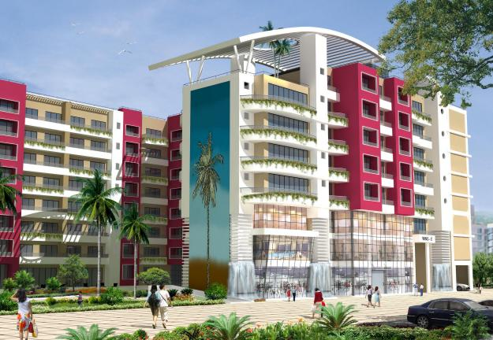
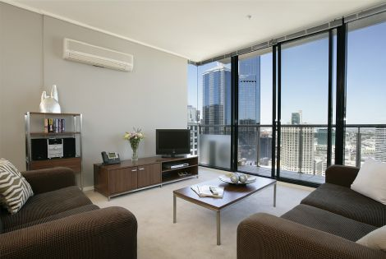
Front elevation and Hall

Slide 5
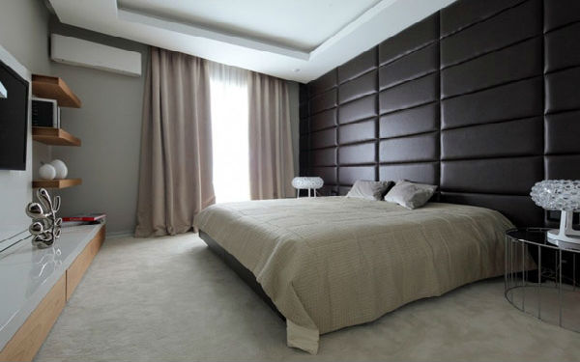
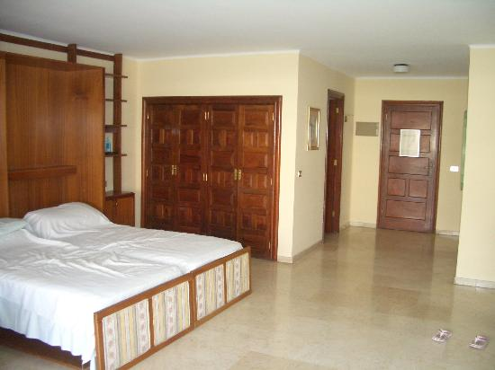
Master Bed Room and other bed room

Slide 6
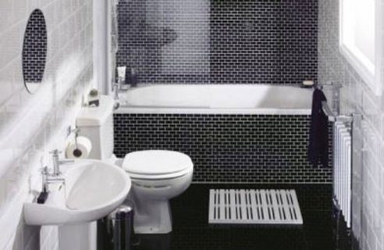
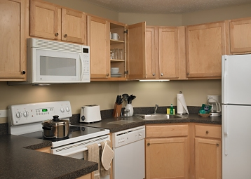
Kitchen & Bathroom

Slide 7
Advantages with Online Video Ads
The major advantage with online video ads when you compare with the TV ad is that TV ad will be shown at a particular date and time, people should watch whenever they broadcast, but whereas the online video ads can be played wherever and whenever the buyer or exact customer can search and view the ad at any date and anytime from anywhere in the world in the PC’s, Tablets and Smart Phones.

Slide 8
Two Way Communication Ad
Two Way Communication Ad means, in TV Ad and News Paper Ad only the costumer will see the Ad and call you back, but in our internet Video Ad the Costumer can Call, send mail instantly and they can see your website about your services instantly. It is called Two Way Communication in between the Advertiser and the Costumer.

Slide 9
Our Strengths
Our Site appears on first page in the Google Search engine for several major search key words for example: Flats for Rent in Hyderabad, Commercial Property for Rent in Hyderabad,

Slide 10
How we will help you
You pay very less to grow your business, we are here to help you to produce your video and Advertise in VideoAdsHyderabad.Com .We see that our Advertisers are happy with our services, by promoting our site in online and offline to increase the viewership.

Slide 11
Major categories who get benefit out of our Services !

Slide 12
Real Estate
Builders & Construction Companies to sell their Apartments, Commercial & Office Spaces. Rent out flats, Commercial & Office Spaces and Home Loans.

Slide 13


Slide 14
Textile
Saree Shops, Readymade Garments shops, kids wear, Women’s wear and Men’s Wear Showrooms

Slide 15

Textile & Saree Ad

Slide 16
Jewelers
Silver, gold and diamond Showrooms.

Slide 17

Jewelers Ad

Slide 18
Hotels
Star hotels, budget hotels, & Service Apartments.

Slide 19

Novotel Hotel Ad

Slide 20
Restaurants
Indian, Chinese & Multi cuisine Restaurants.

Slide 21
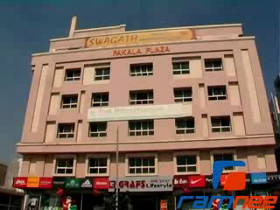
Swagath Restaurant Ad

Slide 22
Hospitals
Multi & super specialty Hospitals, Clinics and Diagnostic centers.

Slide 23
Yeshoda Hospital Ad

Slide 24
Automobile
Car & bike Show rooms, Used Cars and Service Centers, Car Loans

Slide 25

Used Car Ad

Slide 26
Building materials
Steel, Cement and Ceramic Companies, Wall Putties, Paints, Bathroom attachments and Glass.

Slide 27
Anjani Cement Ad

Slide 28
Furniture
Sofa sets, Cots, Cupboards, Office tables & Chairs.

Slide 29
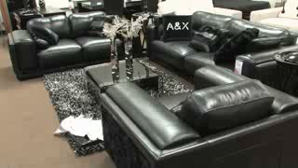
Furniture Ad

Slide 30
Education
CBSE, ICSE, Techno, Concept and Public Schools, Engineering, Medical, Law, CA, Arts & Science and PG Colleges, Business Schools, universities and education loans.

Slide 31

BVRIT Engineering Collage Ad

Slide 32
Electronics
Home appliances, Mobile, Computers and Gadgets Show rooms.

Slide 33
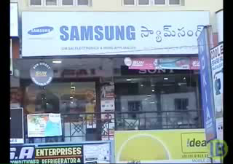
Electronics & Home Appliances Ad

Slide 34
Contact us to Advertise
eBiz Portals Ltd
Plot-122,Raasi Court,
Motinagar,Hyderabad-50018
Mobile: 9014232111, 9177442111
Land: 040-23832111.

